Slide 1
Data Modelling Introduction
IN605 Database 2
Notes:
PREP
Get -
Big roll brown paper
Bunch of pens – different types (biro, whiteboard, pencil too perhaps)

Slide 2
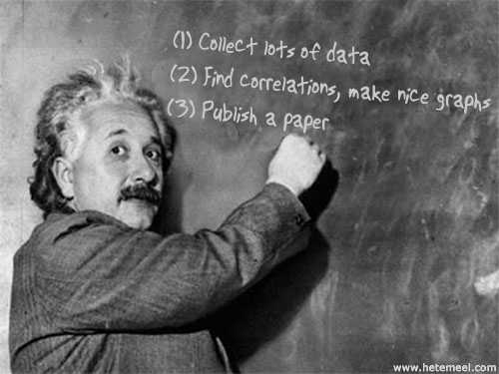
Design is critical
Notes:
Problems with databases are not necessarily caused by a lack of knowledge about the database product itself (although this can eventually become a constraint), but are often the result of having chosen the wrong attributes to group together in a particular table (or spreadsheet). This comes about for two main reasons:
Not having a clear idea of what information the database is meant to be delivering in the short or medium term.
2. Not having a clear model of the different classes of data and their relationship to each other.
What any project requires is a clear understanding of exactly what the database is meant to achieve.

Slide 3
What can go wrong
If you don’t know how the data is going to be used – you may not know what data to collect
If the database is poorly designed,
Some uses may be impossible or difficult
Encourage errors to develop in the database
Notes:
The problem can often be that the initial idea of how to record the data is not necessarily the correct one.

Slide 4

If you don’t have the necessary data …

Slide 5
Just collect everything
So why don’t we collect ALL data and sort it out later?
Exercise – list attributes of an object – just a single type of object - like textbooks

Slide 6
Determine the Use
You need to know what the database is being used for
Use Cases
Diagrams with text detailing use
Useful to identify the data within the problem area (sometimes called “domain”)
Useful for checking model to see if it works with all identified use cases

Slide 7
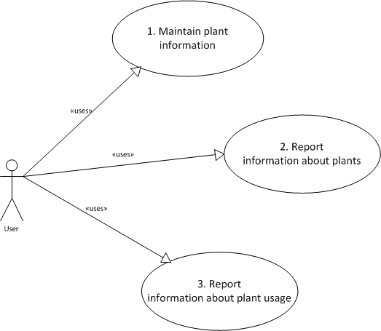
Use Case: A plant database
Use Case 1: Enter and alter data about plants
Use Case 2: Report details about plants
Use Case 3: Report the various uses of plants

Slide 8
Data Model
Once we know what we’re trying to do we can begin modelling the data which we are interested in
Note We are NOT making a model of a database.
We are trying to capture the important aspects of the data
We need to identify
The types of things that exist (as classes)
What makes up those things (attributes)

Slide 9
Classes and Objects
A class is a blueprint or template
A class is a collection of attributes (or properties)
And, maybe methods
not usually in data models
more common in software development)
An object is a particular instance of a class
Notes:
Each Class can be considered a template for a set of similar things (places, events or people) about which we want to keep data.
A class is a blueprint or template
A class is a collection of attributes (or properties)
And, maybe methods
not usually in data models
more common in software development)
An object is a particular instance of a class

Slide 10

Class Symbol
Represented as a rectangle with at most three sections
Top section is the name of the class
Next are the list of attributes
Last is any methods
(we will not use this)
Notes:
Plant
plantID
Genus
Species
Common name

Slide 11
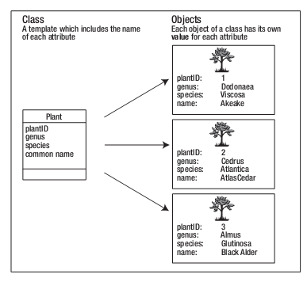
Classes and Objects
A class is the template / plan / blueprint
An object is a particular instance of the class
Churcher, C (2007) Database Design p16

Slide 12
Class / Entity
A class should be the most generic form.
If you have several classes which have similar attributes then you may have duplicated the classes
A petshop database designed from a model with separate classes named Dogs, Cats, Snakes, Rabbits may be better designed just with the object “Animal”
and perhaps another class “Animal Type” but that’s getting ahead of ourselves

Slide 13
Relationships
The associations between entities
The glue that holds the database together
Shown as a line between entities
Each end of the line shows
Cardinality: maximum number
Optionality: minimum number

Slide 14




Optionality & Cardinality using Crows-feet & UML
Cardinality or Maximum: The symbol closest to the end of the line
Optionality or Minimum: Symbol in from the end
Typical examples:
Zero or More......................................... or: 0..n
One or More ................................... or: 1..n
Zero or One.................................. or: 0..1
Exactly one (one & only one)….... or: 1..1

Slide 15
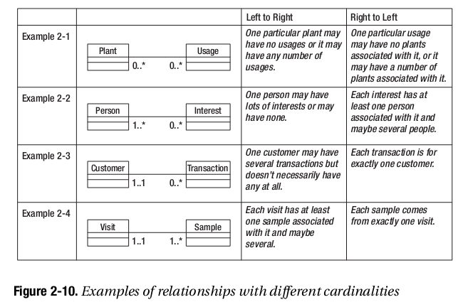
Cardinality Examples (UML)
Churcher, C (2007) Database Design p19

Slide 16
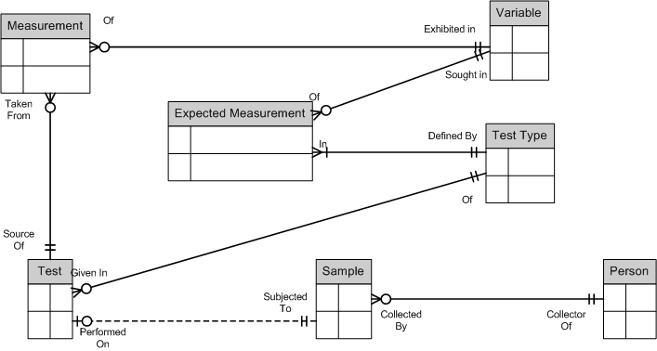
Cardinality Example: Crows-Feet

Slide 17
Reading a Relationship
Think about the entity in one direction
State the first entity
Then use a verb
Finally state the cardinality at the far end
Then reverse it

Slide 18
Reading the Example

Slide 19
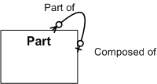
Recursive Relationship
Sometimes we find an entity has a relationship to other instances of the same entity
Sometimes called a “pigs ear”
Notes:
A part is part of zero or one part
A part is composed of zero of many parts

Slide 20
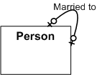
Recursive: one:one (or none)
Notes:
A person is married to one or no persons

Slide 21
Lets try an example
Work in pairs
Student management system
What entities are we going to have?
What attributes will they have?
What relationships will there be?
Notes:
Students
Classes
Lecturers – mislead them into putting down student/lecturer as separate entities
Room ... Getting into timetable

Slide 22
Reading
Read Churcher up to page 23 (1st Ed), 19 (2nd Ed)

